Slide 1
Developing Workflows for SharePoint 2010
Automating business processes
Notes:
In this module you will learn how to create custom workflows for SharePoint 2010 using Visio 2010, SharePoint Designer 2010 and Visual Studio 2010. In addition, you will learn how to incorporate custom forms into your workflow solutions.

Slide 2
Agenda
Why do we need workflow?
Comparing Custom Workflow Creation Tools
Visio 2010 + SharePoint Designer 2010 Workflow
Visual Studio 2010 Workflow
Augmenting SPD2010 Workflows w/ Actions

Slide 3




What is Workflow?
Workflow provides an orderly process
Manages interaction between workers
Automates previously manual processes
Provides process participants with tasks lists
Notes:
Fortunately, new workflow technologies provide the option to automate and coordinate business processes. Workflow allows each of these smaller pieces to be tied together into a larger process. It manages the processes that we used to manage via email and shared files. Without something to manage it, information is lost, people miss email and there is no data stored about the process allowing future improvement via metrics analysis. Workflows allow you to route specific tasks to different actors and systems. Therefore, you can streamline business processes while greatly increasing business efficiency.

Slide 4
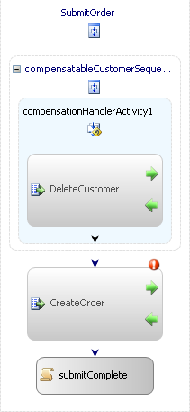
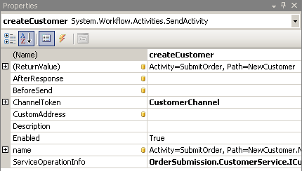
Windows Workflow Foundation
Breaks processes into activities
Activities represent one part of the process
Framework coordinates activity execution
Includes a visual design experience
Notes:
Windows Workflow Foundation (WWF) is a core component of the .NET Framework. WWF breaks processes into logical sections, called activities. Each activity represents one part of the process.
SharePoint developers can develop reusable workflows using SharePoint Designer 2010 or Visual Studio 2010. Both products have a graphical designer and a toolbox with standard activities.
Developers can develop their own custom activities to encapsulate more complex business logic into one activity.
In WWF, a workflow can be defined either purely in XAML or with XAML plus a code-behind file that contains C# or Visual Basic code.
SharePoint Designer helps to create workflows and attach the workflows to a content type like list, document etc., and publishes the workflow on the SharePoint server site.

Slide 5
SharePoint Workflow Targets
List Items
Documents
2010
List Items
Documents
Sites
Document Sets
2007
Notes:
In SharePoint 2007 you can attach workflows to list items and documents. Additionally, in SharePoint 2010 you can add workflows to document sets and sites.
The Sites workflow allows site level operations to occur without the need for an item.
Document sets are an extension of the folder content type that allows a set of documents to be the focus of a workflow.

Slide 6
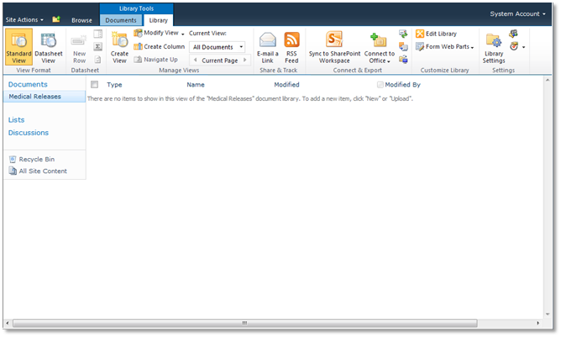
Managing Processes
Workflows are associated with containers
Attached to a site, content type, or list
Associations managed from browser or API
Notes:
Workflows can be associated with a list or content type from within the browser by using the ribbon. Site Workflows can be associated in the browser by navigating to Site Actions and then choosing Site Workflows.
Developers can associate workflows to any container using the SharePoint API. This can be useful for feature receivers that want to create associations when the feature is activated.

Slide 7
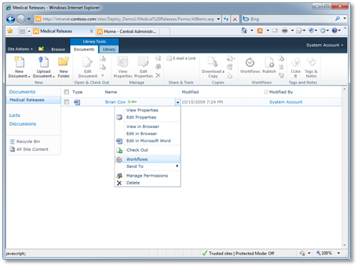
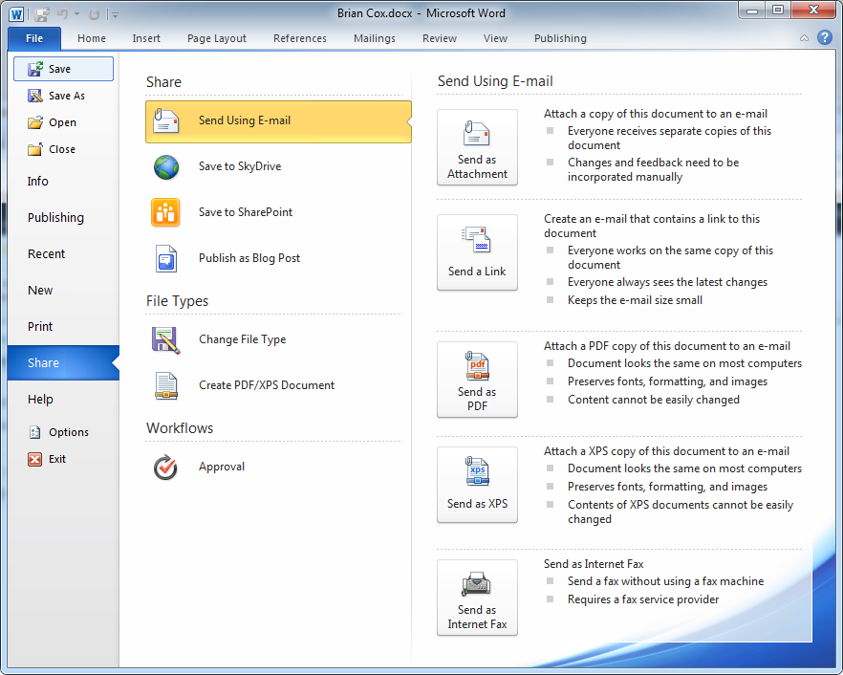
Initiating Workflows
Workflow instances are initiated on items
Sites, items, documents, document sets
Initiated in browser, office client, or API
Notes:
A workflow instance can be initiated on an item through the browser or in SharePoint Designer 2010. In both of these cases the workflow is being started on an item.
Also here you can use the SharePoint API to initiate a workflow on an item.

Slide 8
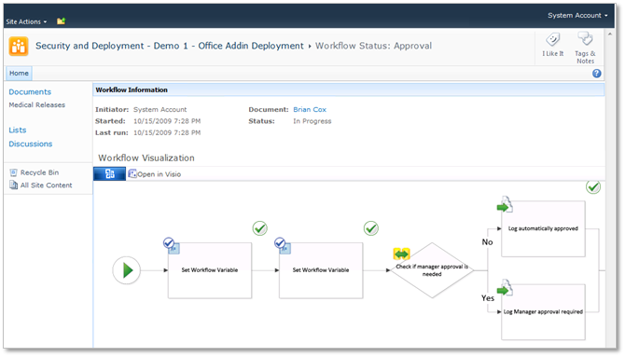
Monitoring Processes
Running workflow instances provide status
Displays status of workflow, tasks, history
Some processes have a visual status
Notes:
After a workflow is initiated, you can visually track the progress and view its status at any given time. Workflow Visualization diagrams can also be used to communicate issues within the process.

Slide 9
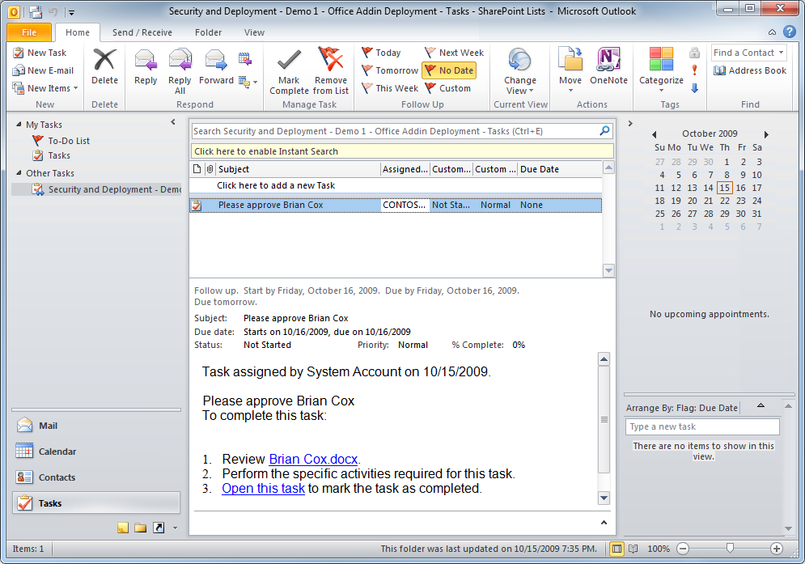
Integrating Tasks with Outlook
Tasks lists in SharePoint sync with Outlook
Allows aggregated “To-Do” list of all tasks
One place to look for all your tasks
Notes:
If processes are spread out and our tasks are separated into multiple locations, how can we aggregate our set of tasks? Outlook allows us to tie them together by importing tasks lists into Outlook. Focus on Outlook as your one stop location for what you need to do today. It gives you the tasks and a way to connect back to the source of the information. It also gives you the TODO list that will aggregate everything into a prioritized list.

Slide 10
DEMO
Creating Workflow Associations

Slide 11
Agenda
Why do we need workflow?
Comparing Custom Workflow Creation Tools
Visio 2010 + SharePoint Designer 2010 Workflow
Visual Studio 2010 Workflow
Augmenting SPD2010 Workflows w/ Actions

Slide 12
SharePoint Designer 2010 Workflows
Ideal tool for building workflows
Create one-time workflows or templated for future use
End user status visualization
Migrate to VS2010 for developers to extend
Limitations:
Loops
Accessing content outside current site/site collection
Working with Web services or feeds
Running elevated privileges ops
Obtaining low-level control & debugging

Slide 13
Visual Studio 2010 Workflows
Useful when SPD2010 capabilities fall short
Must be built by developers
No user friendly status visualization
Challenging to build & deploy

Slide 14
Augmenting SP2010 Workflows with VS2010
Better option instead of building Visual Studio 2010 workflows
Build reusable activities (aka: actions) & deploy to site collections
SPD2010 polls site collection for available actions each time creating/editing a workflow
Can be built as sandbox / full-trust workflows
Ideal as developers build reusable components
Power users still use SPD2010 to build & manage workflows
Notes:
There are quite a few open source projects on CodePlex that contain pre-built actions for SharePoint Designer 2010. Each project contains different actions and has different levels of support, activity and quality.
For a complete list, use this link:
http://www.bing.com/search?q=codeplex+sharepoint+designer+2010+actions

Slide 15
Agenda
Why do we need workflow?
Comparing Custom Workflow Creation Tools
Visio 2010 + SharePoint Designer 2010 Workflow
Visual Studio 2010 Workflow
Augmenting SPD2010 Workflows w/ Actions

Slide 16


Visio and SharePoint Designer
Each tool plays a specific role
Visio allows business analyst to define process
SPD allows power users to implement process
Round Trip Import/Export
Visio 2010
SharePoint Designer
2010
Notes:
SharePoint 2010 and Office 2010 come with a set of tools that can completely cover the business process:
Business analysts can use Visio 2010 to define the process and model the workflow in different tasks in activities and define the roles that are responsible for completing the activity. This design can be exported to SharePoint Designer 2010.
SharePoint Designer 2010 allows power users to implement the process and to deploy it to SharePoint 2010.
More complex workflows can be developed:
From scratch using Visual Studio 2010.
By importing a workflow from SharePoint Designer 2010 and adding the necessary code behind.

Slide 17
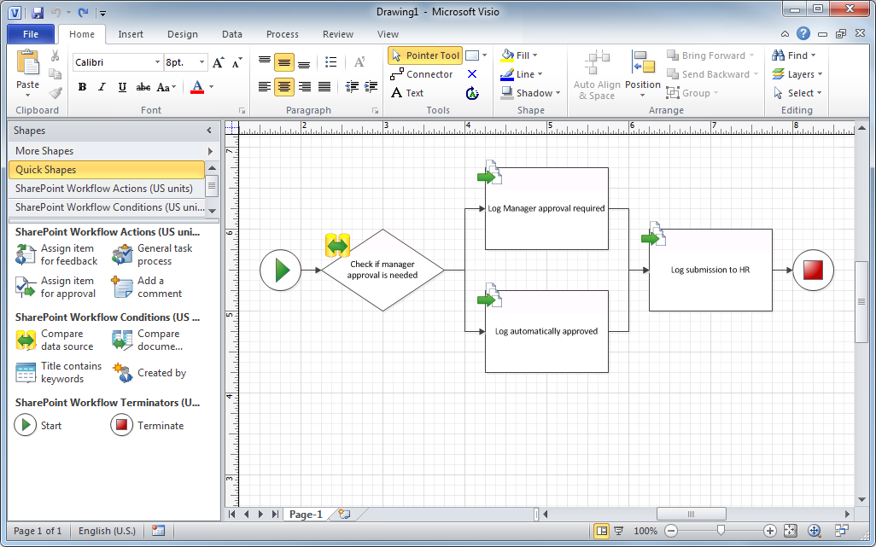
Visio SharePoint Workflow Template
Special SharePoint Workflow Template
Contains shapes for conditions and actions
Allows exporting of process to SPD
Notes:
Visio 2010 comes with a special SharePoint Workflow Template and a toolbox with shapes for conditions and SharePoint activities. Business analysts can easily design and visualize the business process by dragging and dropping actions and conditions onto the designer. It draws a nice and understandable layout, instead of a linear set of steps. It hides the details and focuses on the process flow.

Slide 18
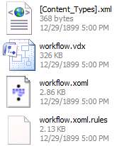
Exporting to SharePoint Designer
Visio exports to a VWI file
Renamed zip file containing all workflow files
*.xoml and *.xoml.rules define workflow
*.vdx file contains Visio drawing
Notes:
Once the process is designed in Visio it can be exported. The resulting file has a .VWI extension, which stands for Visio Workflow Interchange. But it is nothing more than a zip file containing the files that make up the workflow.
The *.xomland *.xoml.rulesfiles define the workflow. (XOML is an XML markup to declare workflows)
The *.vdx file contains the Visio drawing.
In Visio you can only make the actual design of the workflow, not the configuration which is done in SharePoint Designer 2010. SPD 2010 can import the .VWI file, and recognize the different parts that make up the workflow and to allow for modifications.

Slide 19
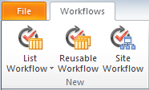
SharePoint Designer
New workflows are attached to a container
List Workflows are attached to a specific list
Reusable Workflows are attached to specific content type
Site Workflows are attached to the current site
Notes:
In SharePoint 2007 you could already attach a workflow to a list or document library. Additionally in SharePoint 2010 you have:
Reusable workflows that are attached to a specific content type.
Site workflows that can be published to the site collection and connect it as needed to each individual list or document library.
From within SharePoint Designer 2010 you can save your reusable workflow or site workflow and publish it to a SharePoint site. This way the workflow can be used in the SharePoint site it was published to.

Slide 20
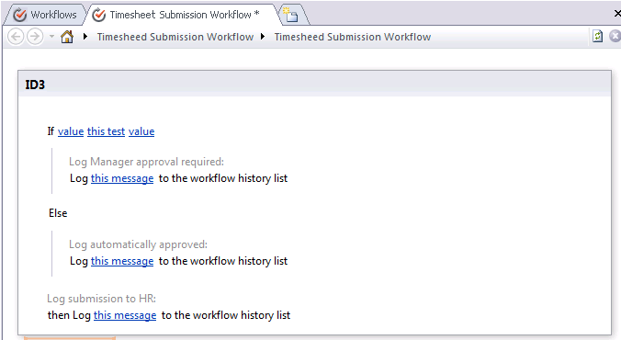
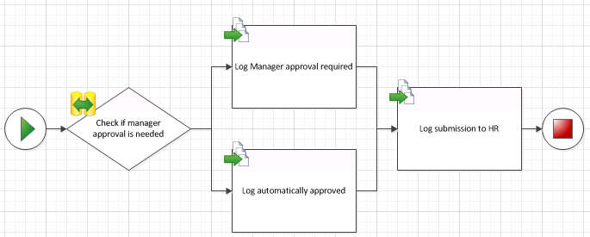
Importing a Visio Process
*.VWI files imported to start development
Generates conditions and actions
Does not set parameters, that’s up to SPD
Notes:
You can use Visio 2010 to define the layout of the workflow. You can then import it in SPD 2010 to refine the layout and fully implement the details. SPD generates a declarative workflow, with no code behind. Parameters cannot be defined in Visio 2010 but can be defined in SPD 2010.

Slide 21
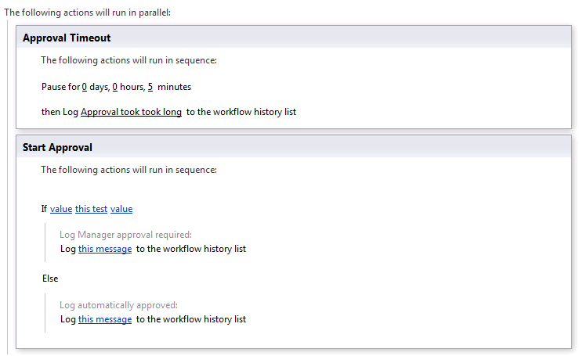
Enhancing the Imported Process
Often changes need to be made to process
New sequential or parallel steps can be added
New conditions or actions can be added
If else blocks are available
Notes:
When the time evolves, changes need to be made to the process to keep it up to date. SPD 2010 allows you to add new sequential or parallel steps, and to add new actions and conditions.

Slide 22
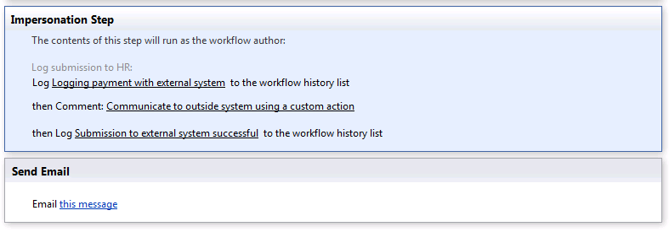
Performing Secure Operations
By default, SPD workflows run as initiator
In SP 2007 this was the only option
In SP 2010 impersonation is possible in SPD
Use an Impersonation Step
Notes:
What if we need the workflow to perform an action the initiator can’t perform? In SP2007 we were out of luck in SPD 2007 and had to use VS, now we can use an impersonation step in SPD 2010.
Keep in mind that the Impersonation step does not impersonate System Account, it impersonates the user that created the workflow. This is important since Administrators don’t need to approve SPD workflows so the process can never have more permissions than the user creating it.

Slide 23
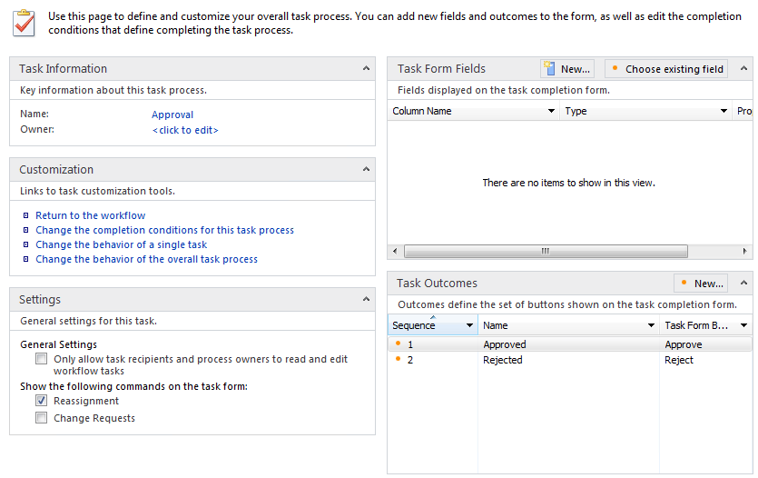
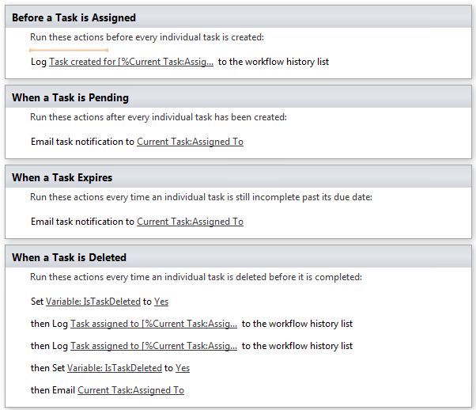
Interacting with Users
SP 2007 only offered basic data collection
SP 2010 offers task processes
Allows specialized conditions for completion
Allows actions to be performed on key events
Started, Pending, Cancelled, Completed
Notes:
Real life approvals are complex. They may involve requesting changes or reassigning tasks. SPD 2007 just had basic data collection, SPD 2010 has full approval processes available.
In SPD 2010 you can use the out of the box approval processes as part of a larger process. You can easily add specialized conditions for completion, and add actions for the key events.

Slide 24
Exporting Workflow to Visio
Changes in SPD can be exported to Visio
SPD exports *.vwi file
Contains updated workflow definition
Imported back into Visio and merged
Notes:
Once changes are done in SPD 2010, they can be exported to Visio 2010 again. SPD 2010 exports the *.VWI file containing the XOML for the workflow. This *.VWI file can then be imported back in Visio 2010 and merged with the existing image.

Slide 25
DEMO
Visio & SharePoint Designer Workflow

Slide 26
Agenda
Why do we need workflow?
Comparing Custom Workflow Creation Tools
Visio 2010 + SharePoint Designer 2010 Workflow
Visual Studio 2010 Workflow
Augmenting SPD2010 Workflows w/ Actions

Slide 27

Custom Workflows in SP2010
SharePoint Designer or Visual Studio 2010
SPD targeted to Power Users
Visual Studio targeted to Developers
Integration allows users to work together
SharePoint Designer
2010
Visual Studio 2010
Notes:
The roles that each tool plays is important. Convey that each tool caters to a specific user enabling them to collaborate. The goal is not to create a set of tools that are in conflict. Allowing each tool to play to it’s strengths:
SPD provides quick solutions that are buildable by power users. This can be a business analyst or a manager that needs a quick solution.
Visual Studio provides a robust development environment that requires more specialization to use, but also provides more power.
Each tool has it’s strengths so by using them both together to build applications we can leverage the strengths of each of these.

Slide 28


Bringing SPD and VS Together
Both tools can be used together
SPD Workflows can be imported into VS
VS can create custom SPD Actions
Allows for two way collaboration
Workflows
Custom Actions
Power User using SPD 2010
Developer using VS2010
Notes:
Using SPD and VS together can leverage the advantages of both tools and more importantly leverage the skills of the target users of each tool.
Export/Import Workflow Scenario:
A manager creates a simple workflow to manage approval of press releases. This workflow allows them to be notified when a new press release is submitted and manage the approval process. It is so successful that other departments want to use it. The IT department is asked to take this prototype workflow and add some reporting functionality and an integration point with a LOB system that manages all press releases. A developer in the IT department exports the existing workflow from SharePoint and imports it into Visual Studio 2010. They modify the workflow as appropriate using the capabilities of Visual Studio and publish it as a SharePoint solution. The solution is deployed to the entire farm and all departments can now use the approval workflow.
Custom Actions Scenario:
The IT department is asked to help several department automate their document archiving processes. Each department has slightly different rules, but they all have one task in common; they need to submit information to an existing LOB system. Since SPD fits their needs in all cases except this one interaction, a developer in the IT department creates a custom activity to manage the interaction with the external system and wraps it as a custom SPD action. Using Visual Studios SharePoint solution project, they package their custom action and deploy it to the farm. Each department is now able to build their own custom process in SPD using the custom action developed in Visual Studio.

Slide 29
Visual Studio 2010 SharePoint Tools
New project templates for SharePoint 2010
Project items for SharePoint items e.g. workflows, content types, list instances, etc…
Automatic WSP generation and deployment
Designer based management of Features
Notes:
The new tools for SharePoint 2010 in Visual Studio allow developers to focus on their applications, not the details of building solutions or features. The wizards and designers handle most of the details of the feature.xml and elements.xml files.
They also have automatic WSP and Feature generation support. The Deploy and Retract project actions execute a set of steps that will update the package in development. This allows developers to update a package, click deploy and have all the steps of package retraction, package deployment, IIS reset, and feature reactivation in one simple action.
Parameters line where the solution is deployed and how it is deployed in development are properties of the project.

Slide 30
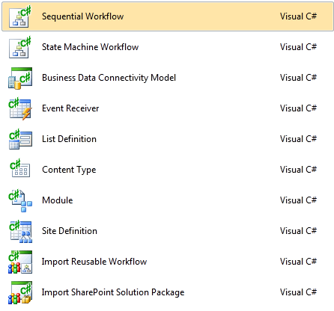
Creating VS 2010 Workflow
SharePoint 2010 Project Types for Workflow
Import Reusable Workflow
Sequential Workflow
State Machine Workflow
Notes:
Visual Studio 2010 offers the possibility to import a Reusable Workflow from SharePoint Designer 2010 and convert it to a code workflow for use in your SharePoint sites. But you can also build workflows from scratch using Visual Studio. The Visual Studio 2010 Tools for SharePoint 2010 have two project templates for developing workflows:
Sequential Workflow
State Machine Workflow
These workflow types aren’t the only option. It’s possible to create an empty project or any type of SharePoint project and add a new Workflow Project Item to it.

Slide 31
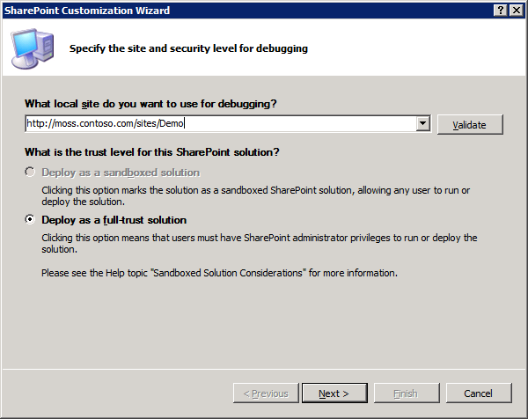
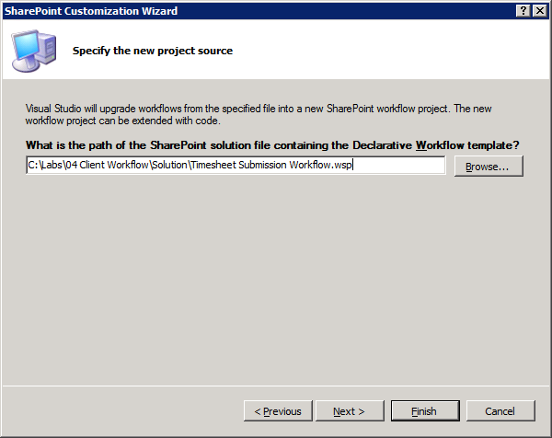
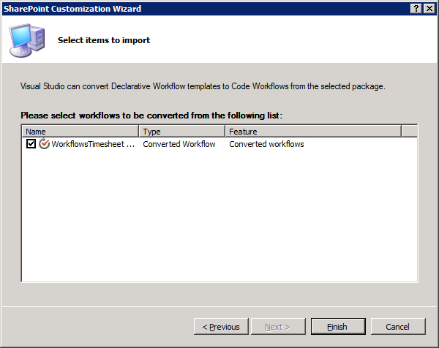
Importing Reusable Workflow
Converts WSP into Workflow project item
Allows extension of existing SPD workflows
Moves workflow into source controlled project
Allows inclusion of workflow into full application
Notes:
From within SharePoint Designer 2010 you can package your reusable workflow by choosing the Save as Template button on the ribbon. This saves the workflow into a *.wsp file and uploads it to the Assets document library in your SharePoint site. Before you can import the *.wsp into Visual Studio 2010, you have to download the *.wsp file.
When you use Visual Studio 2010 Tools for SharePoint 2010 to import a Reusable Workflow from SharePoint Designer 2010, the *.wsp file is imported and converted into a Workflow project item, and added as a part of a solution.

Slide 32
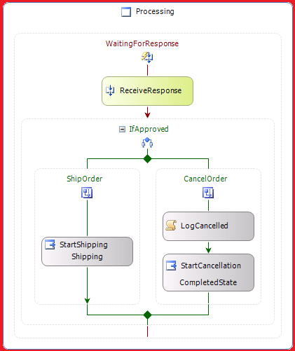
Sequential Workflow
Process steps are linear
One activity complete before the next
Some SPD activities can be used in VS2010
Requires special ApplyActivation activity
Notes:
Sequential workflows are not any different from SP2007, the primary difference is that the tools in VS 2010 allow developers to focus on the workflow while all the details are taken care of by the tools.
SPD Action activities can be used in VS2010 as well. They aren’t added by default to the toolbox, but they can be added manually. The only requirement is the ApplyActivation object must be placed in the workflow to provide the value needed by the __context variable of SPD Action activities.
Note on the “Some SPD activities can be used in VS2010”:
Technically they can all work, but many of the activities such as string conversion or string manipulation aren’t useful since it’s easier to do that in code instead of using custom activities. SPD doesn’t have this option, so the activities are needed in that context.

Slide 33
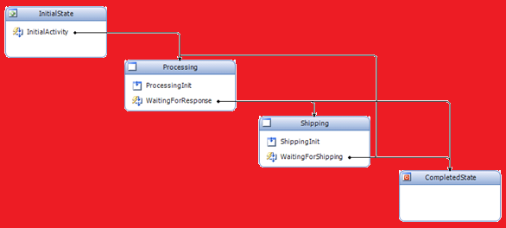
State Machine Workflow
Process steps are not always linear
External events trigger state transitions
Work happens during transitions
Actually small sequential workflows
Notes:
State Machine workflows are not any different from SP2007, the primary difference is that the tools in VS 2010 allow developers to focus on the workflow while all the details are taken care of by the tools.
Scenario:
a document is created and over time other processes modify its status value. These changes cause state transitions in the workflow that move the document between different stages of a larger process. It’s possible at any point in time some sort of external event may cause a state transition back to a previous step. State Machines are suited to this since they understand non-linear transitions unlike sequential workflows. Implementing the same process in a sequential workflow could require an extremely complex system of state variables and conditions that a State Machine Workflow would handle for you.

Slide 34
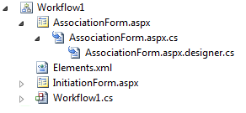
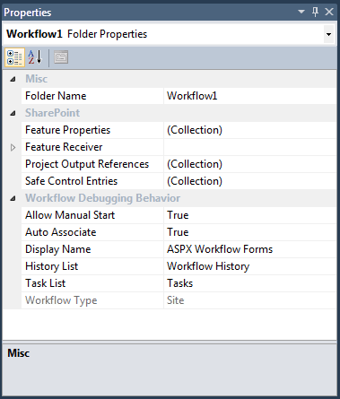
Workflow Project Item
Manages all workflow files
Contains and manages element.xml file
Contains workflow and custom forms
Manages addition of a feature receiver
Notes:
Scenario:
a document is created and over time other processes modify its status value. These changes cause state transitions in the workflow that move the document between different stages of a larger process. It’s possible at any point in time some sort of external event may cause a state transition back to a previous step. State Machines are suited to this since they understand non-linear transition unlike sequential workflows. Implementing the same process in a sequential workflow could require an extremely complex system of state variables and conditions that a State Machine Workflow would handle for you.

Slide 35
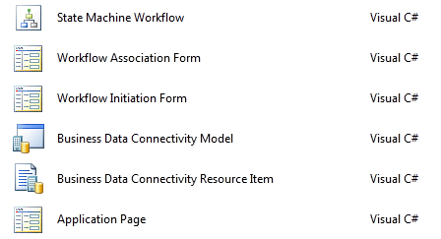
Custom ASPX Forms in SharePoint 2010
Templates exist for workflow forms
Standard form code provided by template
Updates to elements.xml handled by designer
Notes:
A workflow association form is needed when the workflow is associated with a list, and the administrator still needs to configure some details. A workflow initiation form is displayed to the user when a workflow is started on a list item. It allows the workflow to gather parameters before it gets started.
Visual Studio 2010 Tools for SharePoint 2010 offer the possibility to use SPIs to create an .ASPX Workflow Association Form or an .ASPX Workflow Initiation Form. The new form is automatically associated with the workflow. Standard form code is provided and must only be completed to adhere to your needs.
They are deployed as part of a feature and this way new versions of the forms can easily be deployed to the SharePoint server.

Slide 36

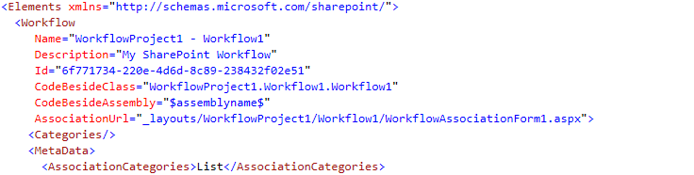
Deploying Custom Forms
Visual Studio 2010 handles form settings
Custom forms deployed in _layouts folder
Form URL added to elements.xml
Notes:
The method called GetInitiationData needs editing in the code behind of the ASPX file. This method only returns a string. If there are multiple values, it is recommended you serialize them into an XML fragment before returning them. Once the workflow instance is running, it is easy to get to this string just by referencing workflowProperties.InitiationData. The multiple values will need to be de-serialized from the XML fragment if they were serialized in GetInitiationData.
Previously deployment wasn’t easy within Visual Studio, now it’s just a right click and Deploy. You can even add forms to the workflow and the deploy tools will get them to the right location. This allows us to take our custom forms and easily test and deploy them.

Slide 37
DEMO
Developing Workflow Templates with the Visual Studio 2010 SharePoint Tools

Slide 38
Agenda
Why do we need workflow?
Comparing Custom Workflow Creation Tools
Visio 2010 + SharePoint Designer 2010 Workflow
Visual Studio 2010 Workflow
Augmenting SPD2010 Workflows w/ Actions

Slide 39
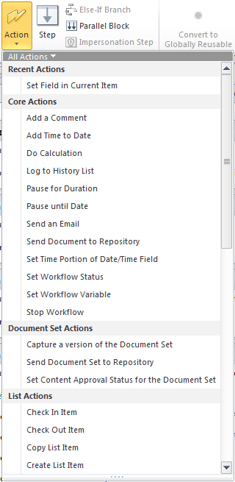
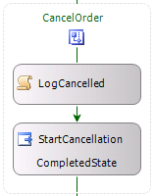
Custom SPD Actions in VS
Actions are Windows Workflow Activities
Compiled into assemblies
Deployed to the server
Integrated into *.ACTIONS files
.ACTIONS
Notes:
With Visual Studio 2010 you can easily develop custom activities and compile them into an assembly. When deployed to the server, they can be integrated into the *.ACTIONS file of SharePoint Designer. This way your custom activities are exposed to SharePoint Designer and can be used in SPD workflows.

Slide 40
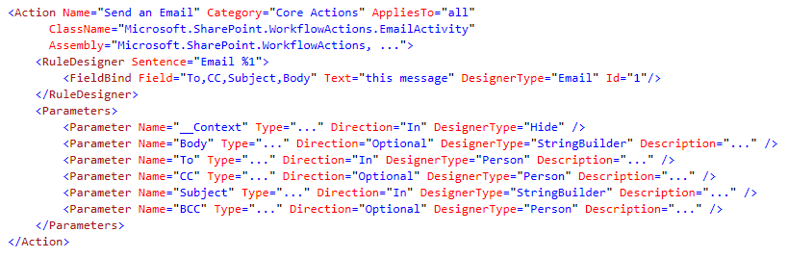
Adding custom Actions
Custom Actions registered in *.ACTIONS file
ACTIONS files in TEMPLATE/[LCID]/Workflow
One file for each locale id
Maps from SPD syntax to Activity properties
Notes:
The process of deploying custom actions is two parts, first the activities have to be created, then they need to be registered. The tools allow us to include the activities in an assembly that will be deployed in our solution.
The deployment consists of adding the custom activity, adding the actions file, and adding an entry to the web.config file to allow the activity to be trusted.

Slide 41
DEMO
Developing Custom Actions for SharePoint Designer 2010 Workflows

Slide 42
Summary
Why do we need workflow?
Visio 2010 + SharePoint Designer 2010 Workflow
Visual Studio 2010 Workflow
Augmenting SPD2010 Workflows w/ Actions

